Slide 1
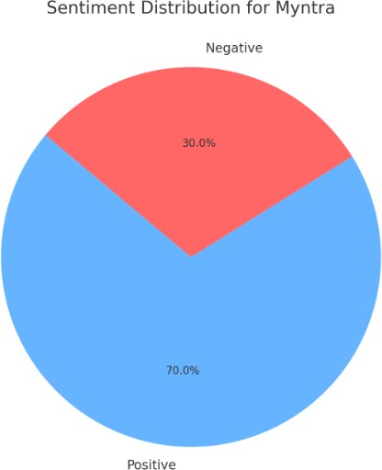
Myntra: Social Media Sentiment, Brand Perception, Market Trends, and Competitive Landscape Analysis
Introduction
This report provides a comprehensive analysis of Myntra's brand perception, customer sentiment, emerging market trends, and its position in the competitive landscape. The goal is to provide actionable insights that can help Myntra enhance its market position and customer satisfaction.
Social Media Sentiment Analysis
Social media sentiment analysis involves collecting data from various platforms and categorizing them into positive, negative, or neutral sentiments. This section summarizes the overall sentiment towards Myntra based on customer comments and reviews.
Key Visualizations:
Graph showing the distribution of sentiments (positive, negative, neutral).
Major themes identified from customer feedback.

Slide 2
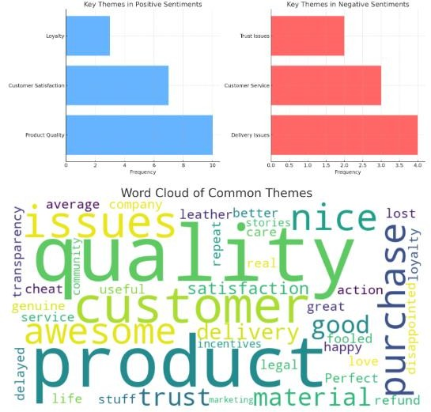
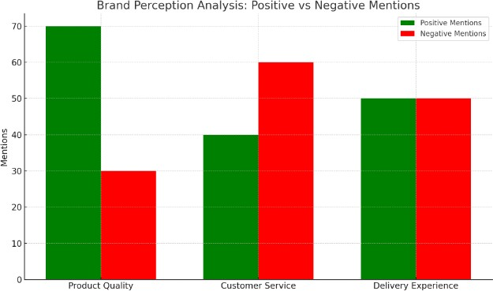
Brand Perception Analysis
Brand perception analysis focuses on understanding how customers view Myntra, including both positive and negative attributes. This section analyzes the overall perception based on customer reviews and social media discussions.
Key Findings:
Common themes such as product quality, customer service, and delivery experience.

Slide 3
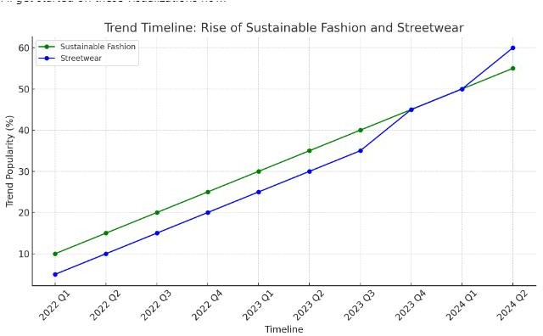
Market Trends Identification
Market trends identification is crucial for understanding customer preferences and emerging fashion trends. This section tracks trends such as sustainable fashion and streetwear, providing insights into what customers are increasingly interested in.
Key Visualizations:
Trend timelines showing the rise of sustainable fashion and streetwear.
Heatmap of regional popularity of sustainable fashion.
Bar graph highlighting the frequency of key fashion trends.

Slide 4
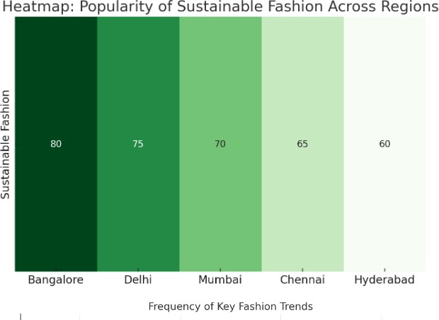
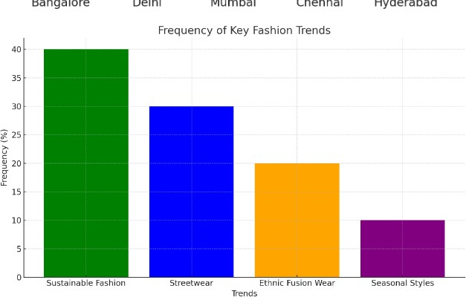
Competitive Landscape Assessment
This section evaluates Myntra's position relative to its competitors—Amazon Fashion, Flipkart, and AJIO. It analyzes customer satisfaction, product range, pricing strategy, and overall market presence to identify opportunities for differentiation.
Key Visualizations:
Competitor positioning map showing relative positioning based on customer satisfaction and product range.
Bar chart comparing customer satisfaction scores across platforms.
Pricing comparison graph visualizing the average pricing differences among competitors.

Slide 5
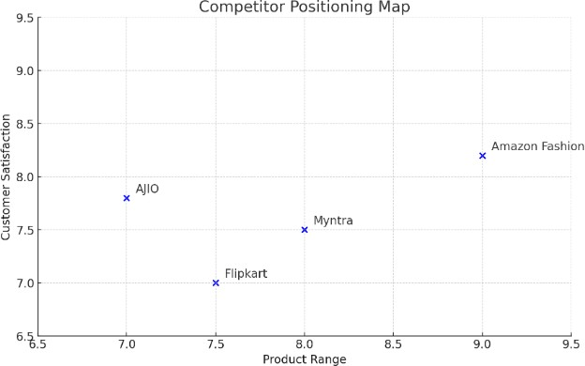
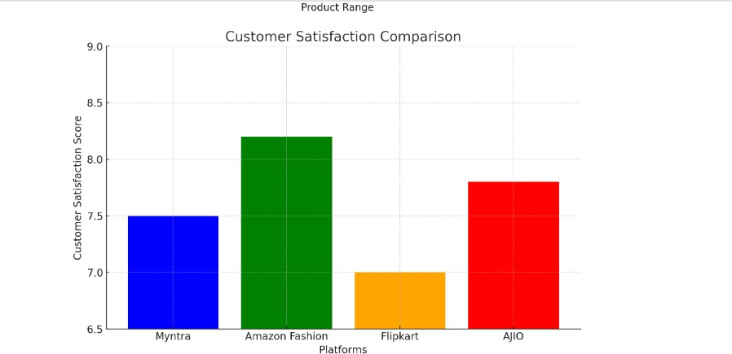

Slide 6
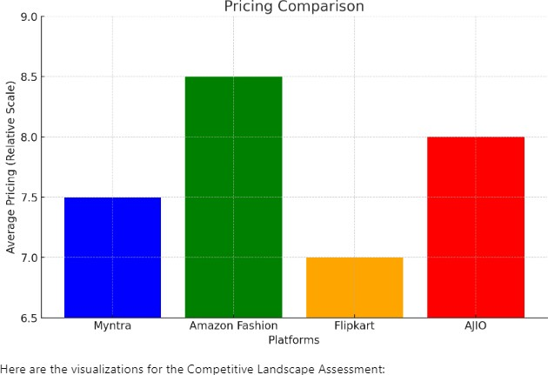
Strategic Recommendations
Based on the analysis, the following strategic recommendations are proposed to help Myntra enhance its market position and customer satisfaction:
Improve customer service by reducing response times and enhancing issue resolution processes.
Expand product range to offer a wider variety of categories, including more exclusive and premium brands.
Consider personalized discounts or loyalty programs to remain competitive in pricing.
Enhance marketing efforts through influencer partnerships and region-specific campaigns.
Conclusion
This report provides a detailed analysis of Myntra's brand perception, customer sentiment, market trends, and competitive landscape. By implementing the strategic recommendations, Myntra can strengthen its market position, enhance customer satisfaction, and stay ahead of the competition.

